Slide 1
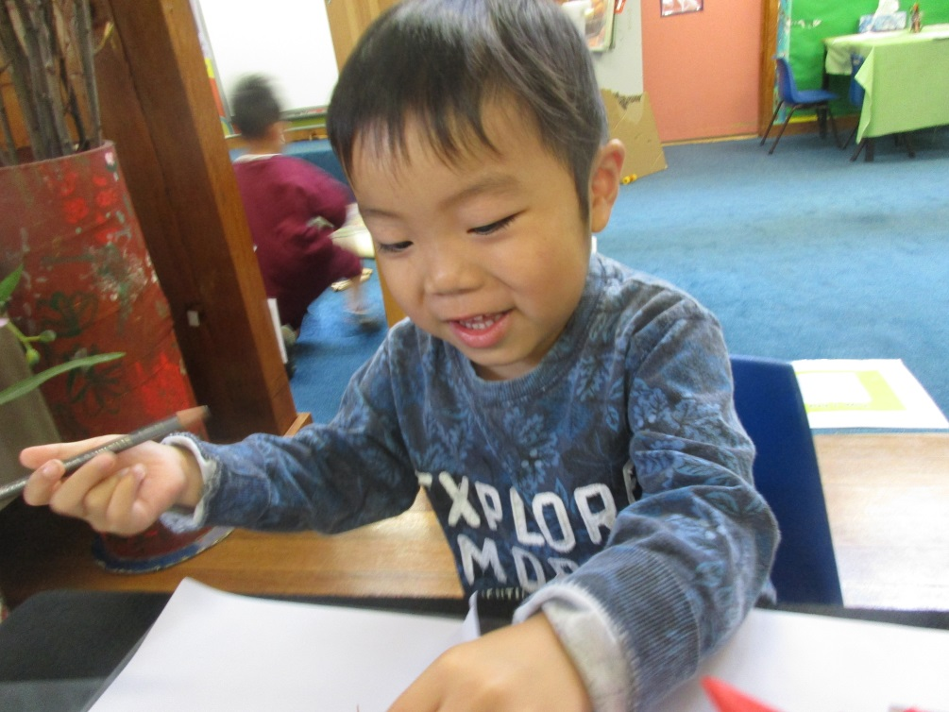
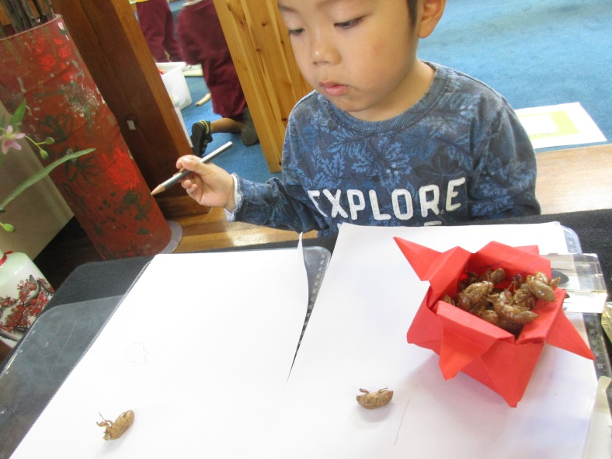
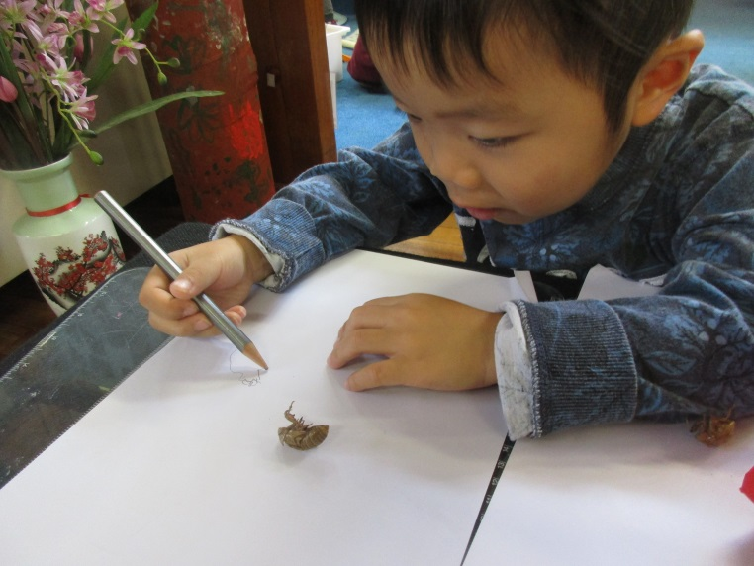
Toby’s deconstructed drawing of a cicada shell
Toby, to extend your interest in snakes, I had organised a real baby python to visit preschool but unfortunately that didn't fall through, however just as I was contemplating plan B Ms Anna drew my attentions to a live cicada right outside our preschool door!!!!! This must have been divine intervention !We carefully scooped up the cicada- I couldn't wait to show you this the next day. Just as I expected you couldn't contain your excitement, asking questions and making predictions about where it lives and what it eats. Today I found you at the table with the cicada shells, looking at them with a magnifying glass, I invited to draw a diagram of the shell. You readily took up the challenge and began to draw, starting with the bottom and then the body. You tell me you can see the lines on its body and proceeded to draw them. You then added the head and drew many eggs inside the body. There is also a crack on the body which you
pointed out to me and explained that's where the cicada comes out. I explained to you that someone who doesn't know much about cicadas might not understand what you've drawn so I suggested we label the parts together, you agreed that it was a great idea. I wrote down the words egg and crack for you to copy, I was impressed you had a go and asked for help when you couldn't write certain letters. I loved the end result and am really proud of your efforts today! Well done Toby!

Slide 2
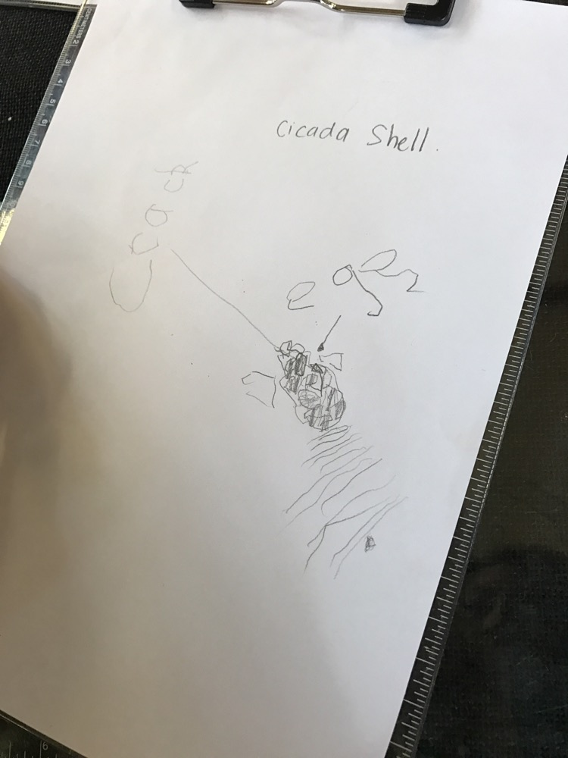
Analysis of the Learning
Toby, your mum tells me she finds it hard to get you to sit still for anything. I find this puzzling and hard to believe because you have shown so much enthusiasm, persistence and creativity in this task today. Even when some letters were tricky for you to write , you persisted and asked for help and together we were able to co-construct the labels for your diagram. You are a keen observer, noticing little details such as the lines on the shell, the crack on the back and the little eyes on its head. You are obviously a very confident communicator, clearly articulating your new knowledge about cicadas with me.
Links to EYLF
LO5 – Toby, you are a able to confidently interact with others and share new understandings.
LO4- You are a confident learner, showing curiosity, cooperation, confidence, creativity, commitment and persistence in this task.
Future Directions
Lets, extend on this interest you have in cicadas. We could explore the life cycle of the cicada. We could use drama and movement to further your emergent literacy skills by retelling facts about the cicada and then acting them out. Lets involve your classmates and pretend we are a roomful of cicadas malting and transforming!
Written by Ms Lien Chai on 19/3/2017

